Slide 1
Thomas Jefferson-1801-1809

Slide 2
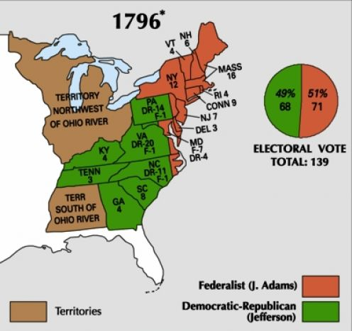

Slide 3
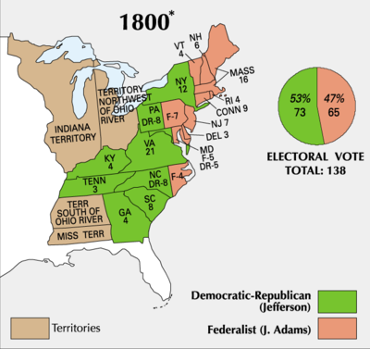

Slide 4
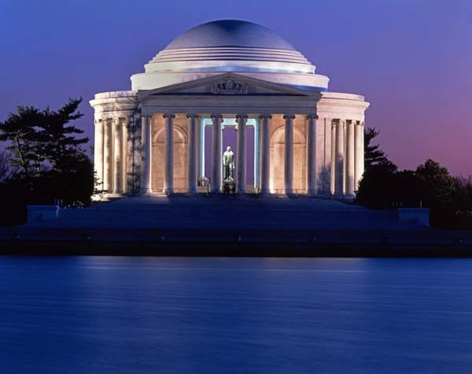

Slide 5
Jefferson’s Dilemma
Offered France’s Louisiana Territory
Jefferson was a Strict Constructionist
Follow Constitution to the letter no using
The Elastic Clause-Necessary and Proper
Decided purchase was best for nation
Louisiana Purchase 1803-
Doubled size of nation
$15 million-.03 acre-524,800,000 acres

Slide 6
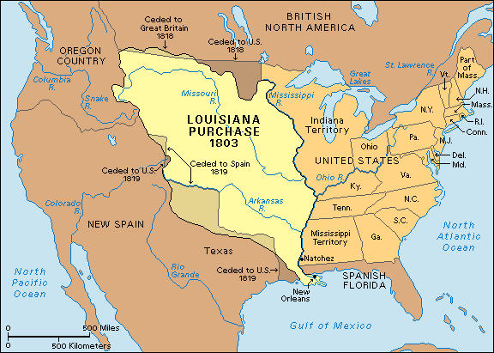

Slide 7
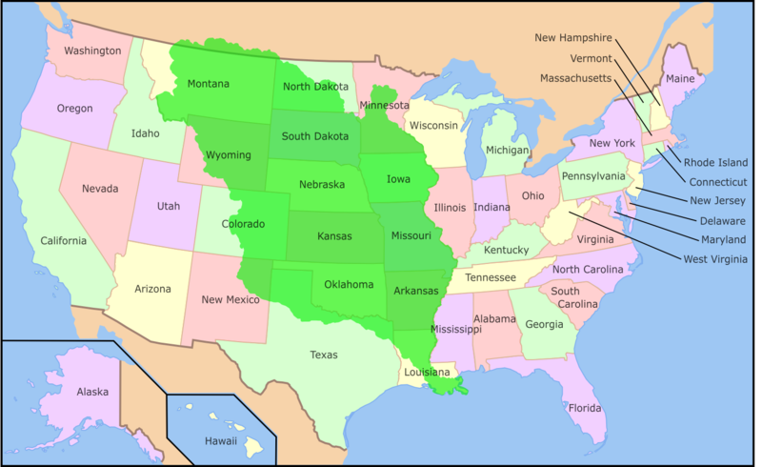

Slide 8
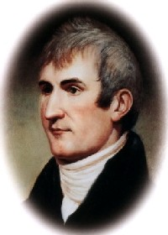
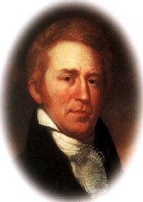
Lewis and Clarke Expedition
Meriwether Lewis
William Clark

Slide 10
Foreign Affairs Problems

Slide 11
Foreign Affairs Problems
Britain and France disrupted American trade
Destroyed American Merchant Ships
British forced Americans into their navy-
Known as Impressment
Jefferson enacted
The Embargo Act 1807-
Forbid all American ForeignTrade-
Made economy worse-
Repealed law-No trade w/Br. or Fr.

Slide 12
Foreign Affairs Problems
Freedom of the Seas would continue to be a problem for the next president
James Madison.

Slide 13
